Slide 1
Week Six:
Isaiah 34-49 and Mark 9:1-12:27

Slide 2
https://www.youtube.com/watch?v=d0A6Uchb1F8
Week Six:
Isaiah Overview, Hezekiah, Rich Young Ruler

Slide 3
Donnie Martin
Matt Chandler
Francis Chan
The Bible Project
Week Six:
Isaiah Overview, Hezekiah, Rich Young Ruler

Slide 4
Bible Project
Isaiah part 1:
(~8 minutes)
https://www.youtube.com/watch?v=d0A6Uchb1F8

Slide 5
The Bible Project: ISAIAH

Slide 6
John 16:33
“In the world you will have tribulation: but be of good cheer; I have overcome the world.”

Slide 7
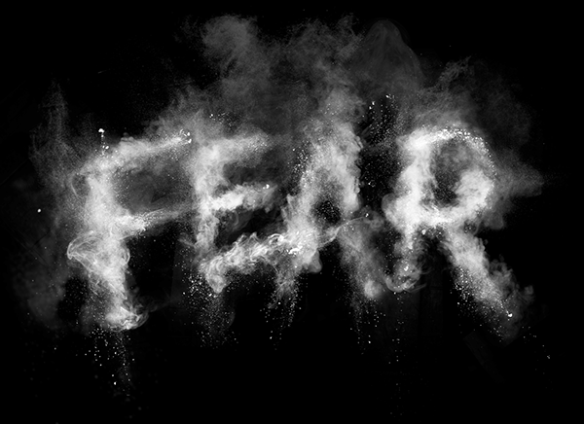
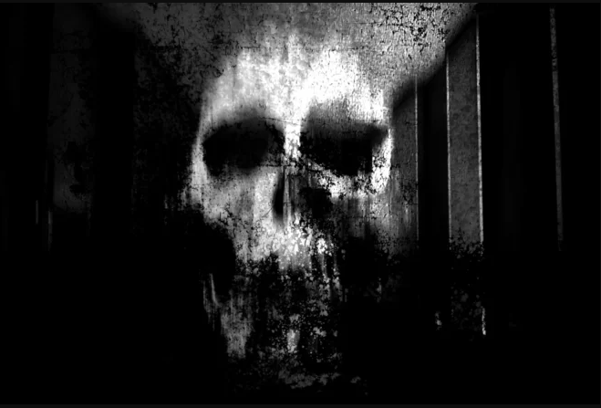
John 16:33
“In the world you will have tribulation: but be of good cheer; I have overcome the world.”

Slide 8
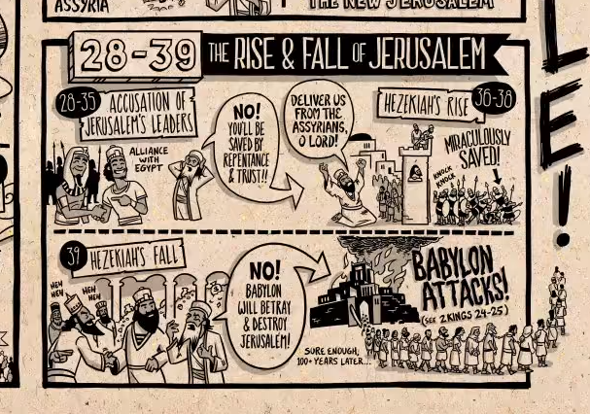
Hezekiah

Slide 9
Fear was born out of the enemy’s threats.

Slide 10
Isa. 36:1 In the fourteenth year of King Hezekiah’s reign, Sennacherib king of Assyria attacked all the fortified cities of Judah and captured them. 2 Then the king of Assyria sent his field commander with a large army from Lachish to King Hezekiah at Jerusalem.

Slide 11
Isa. 36: When the commander stopped at the aqueduct of the Upper Pool, on the road to the Launderer’s Field, 3 Eliakim son of Hilkiah the palace administrator, Shebna the secretary, and Joah son of Asaph the recorder went out to him.

Slide 12
Isa.36:4 The field commander said to them, “Tell Hezekiah: “‘This is what the great king, the king of Assyria, says: On what are you basing this confidence of yours? 5 You say you have counsel and might for war—but you speak only empty words. On whom are you depending, that you rebel against me?

Slide 13
Isa.36:6 Look, I know you are depending on Egypt, that splintered reed of a staff, which pierces the hand of anyone who leans on it! Such is Pharaoh king of Egypt to all who depend on him.”

Slide 14
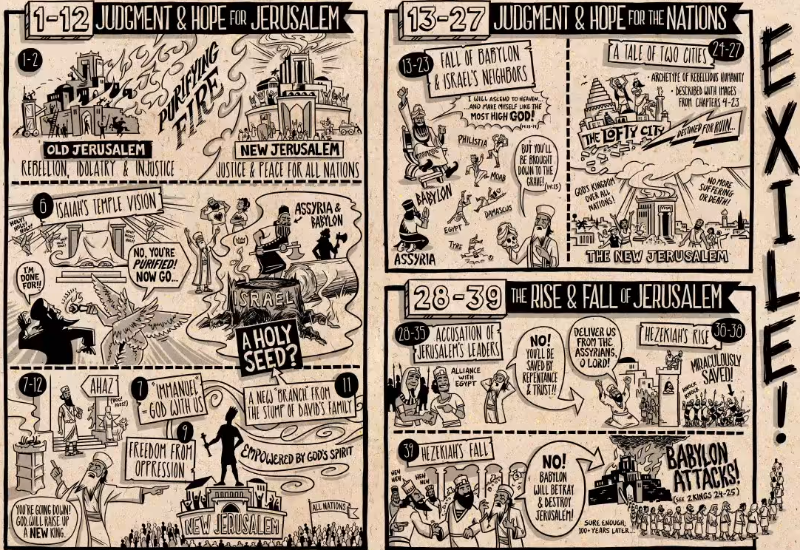
Isa.36:6 Look, I know you are depending on Egypt, that splintered reed of a staff, which pierces the hand of anyone who leans on it! Such is Pharaoh king of Egypt to all who depend on him.”

Slide 15
FEAR:
-You can’t depend on Egypt!

Slide 16
“Faith has three main elements. In the first place, it is trust in God. It is a confidence in the trustworthiness, fidelity and reliability of God. It is about rejoicing in his presence and power, being open to his prompting and guidance through prayer, and experiencing the motivation and comfort of the Holy Spirit. …

Slide 17
It is a deep sense of longing to be close to God, of wanting to praise his name, of being aware of his presence. In many ways, this aspect of Christian faith is like being in love with someone: you want to be with them, enjoying their presence and feeling secure with them.

Slide 18
It concerns the heart, rather than the head; it is emotional, rather than intellectual. It is the powerhouse of Christian life, keeping us going through the difficult times and exciting us during the good times. The difficulty is that all too many people seem to get no further than this stage. Their faith can easily become nothing more than emotion. …

Slide 19
It can become superficial, lacking any real depth. It seems shallow. It has not really taken root, and is very vulnerable. Yet faith can only flourish when it sinks deep roots. There is more to faith than emotion, experience and feelings, however important they may be to you. …

Slide 20
Christianity isn’t just about experiencing God—it’s about sticking to God. A mature faith is something secure, something that you can rely on. If your faith is not deeply rooted, you will be tempted to find security in something else, only to find that this alternative will fail you.”
–Alister Mcgrath

Slide 21
Isa.36:8 “‘Come now, make a bargain with my master, the king of Assyria: I will give you two thousand horses—if you can put riders on them! 9 How then can you repulse one officer of the least of my master’s officials, even though you are depending on Egypt for chariots and horsemen?”

Slide 22
FEAR:
-You can’t depend on Egypt!
-Look at your weaknesses!

Slide 23
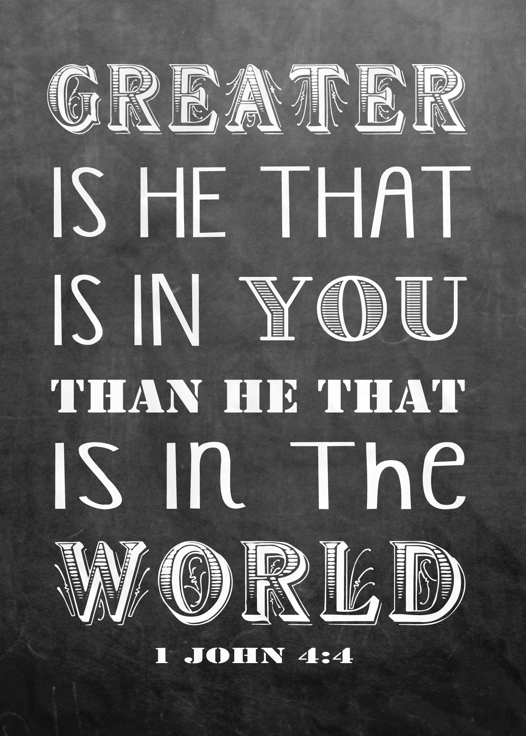
Isa.36:8 “‘Come now, make a bargain with my master, the king of Assyria: I will give you two thousand horses—if you can put riders on them! 9 How then can

Slide 24
FEAR:
-You can’t depend on Egypt!
-Look at your weaknesses!
-God wants you destroyed!

Slide 25
Isa.36:10 Furthermore, have I come to attack and destroy this land without the Lord? The Lord himself told me to march against this country and destroy it.’”

Slide 26
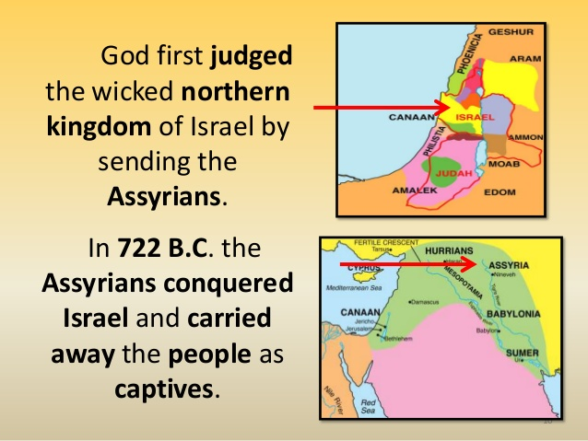
Isa.36:10 Furthermore, have I come to attack and destroy this land without the Lord? The Lord himself told me to march against this country and destroy it.’”

Slide 27
Jesse Pen-Lewis:
“The devil and his wicked spirits will speak, or use, ninety-nine parts of truth to float one lie…”

Slide 28
FEAR:
-You can’t depend on Egypt!
-Look at your weaknesses!
-God wants you destroyed!
-Don’t look at God, look around you!

Slide 29
Isa.36:14 This is what the king says: Do not let Hezekiah deceive you. He cannot deliver you! 15 Do not let Hezekiah persuade you to trust in the Lord when he says, ‘The Lord will surely deliver us; this city will not be given into the hand of the king of Assyria.’

Slide 30
Isa.36:20 Who of all the gods of these countries have been able to save their lands from me? How then can the Lord deliver Jerusalem from my hand?”

Slide 31
Isa.37:9 Now Sennacherib received a report that Tirhakah, the king of Cush, was marching out to fight against him. When he heard it, he sent messengers to Hezekiah with this word: 10 “Say to Hezekiah king of Judah: Do not let the god you depend on deceive you when he says, ‘Jerusalem will not be given into the hands of the king of Assyria.’

Slide 32
11 Surely you have heard what the kings of Assyria have done to all the countries, destroying them completely. And will you be delivered? 12 Did the gods of the nations that were destroyed by my predecessors deliver them—the gods of Gozan, Harran, Rezeph and the people of Eden who were in Tel Assar?

Slide 33
Isa.37:13 Where is the king of Hamath or the king of Arpad? Where are the kings of Lair, Sepharvaim, Hena and Ivvah?”

Slide 34
Isa.37:13 Where is the king of Hamath or the king of Arpad? Where are the kings of Lair, Sepharvaim, Hena and Ivvah?” 14 Hezekiah received the letter from the messengers and read it. Then he went up to the temple of the Lord and spread it out before the Lord.

Slide 35
FEAR:
-You can’t depend on Egypt!
-Look at your weaknesses!
-God wants you destroyed!
-Don’t look at God, look around you!

Slide 36
Isa.37:1 When King Hezekiah heard this, he tore his clothes and put on sackcloth and went into the temple of the Lord. 2 He sent Eliakim the palace administrator, Shebna the secretary, and the leading priests, all wearing sackcloth, to the prophet Isaiah son of Amoz.

Slide 37
Isa.37:3 They told him, “This is what Hezekiah says: This day is a day of distress and rebuke and disgrace, as when children come to the moment of birth and there is no strength to deliver them.

Slide 38
Isa.37:4 It may be that the Lord your God will hear the words of the field commander, whom his master, the king of Assyria, has sent to ridicule the living God, and that he will rebuke him for the words the Lord your God has heard. Therefore, pray for the remnant that still survives.

Slide 39
Hezekiah
His first response when faced with the enemy threat is to
HUMBLE HIMSELF BEFORE GOD.

Slide 40
Hezekiah
Receives word from the Lord:

Slide 41
Isa.37:6 Isaiah said to them, “Tell your master, ‘This is what the Lord says: Do not be afraid of what you have heard—those words with which the underlings of the king of Assyria have blasphemed me. 7 Listen! When he hears a certain report, I will make him want to return to his own country, and there I will have him cut down with the sword.’

Slide 42
Hezekiah
Exercises FAITH
to combat FEAR:

Slide 43
Isa.37:14 Hezekiah received the letter from the messengers and read it. Then he went up to the temple of the Lord and spread it out before the Lord. 15 And Hezekiah prayed to the Lord: 16 “Lord Almighty, the God of Israel, enthroned between the cherubim, you alone are God over all the kingdoms of the earth. You have made heaven and earth.

Slide 44
Isa.37:17 Give ear, Lord, and hear; open your eyes, Lord, and see; listen to all the words Sennacherib has sent to ridicule the living God.
18 “It is true, Lord, that the Assyrian kings have laid waste all these peoples and their lands.

Slide 45
Isa.37:19 They have thrown their gods into the fire and destroyed them, for they were not gods but only wood and stone, fashioned by human hands. 20 Now, Lord our God, deliver us from his hand, so that all the kingdoms of the earth may know that you, Lord, are the only God.”

Slide 46
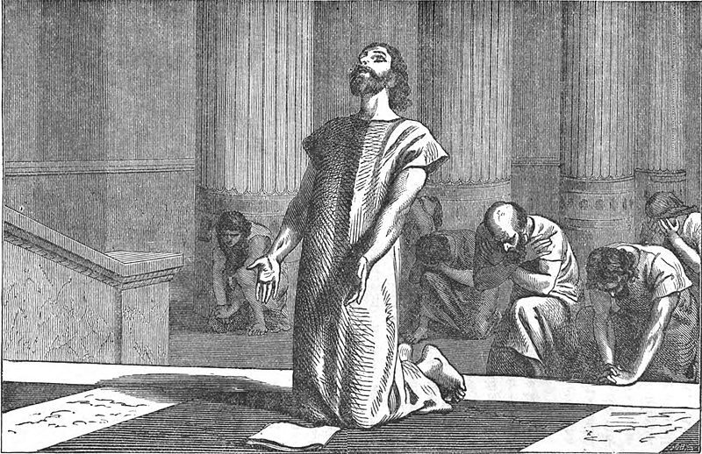
Hezekiah took the letter “…and spread it before the Lord” (37:14).

Slide 47
Hezekiah
Receives God’s Favor:

Slide 48
Isa.37:30 “This will be the sign for you, Hezekiah: “This year you will eat what grows by itself, and the second year what springs from that. But in the third year sow and reap, plant vineyards and eat their fruit. 31 Once more a remnant of the kingdom of Judah will take root below and bear fruit above.”

Slide 49
Hezekiah
Receives Promise of God’s Protection:

Slide 50
Isa.37:33 “Therefore this is what the Lord says concerning the king of Assyria: “He will not enter this city or shoot an arrow here. He will not come before it with shield or build a siege ramp against it. 34 By the way that he came he will return; he will not enter this city,” declares the Lord. 35 For I will defend this city to save it for mine own sake, and for my servant David’s sake.”

Slide 51
Hezekiah
The enemy is defeated:

Slide 52
Isa.37:36 Then the angel of the Lord went out and put to death a hundred and eighty-five thousand in the Assyrian camp. When the people got up the next morning—there were all the dead bodies! 37 So Sennacherib king of Assyria broke camp and withdrew. He returned to Nineveh and stayed there.

Slide 53
Isa.37:38 One day, while he was worshiping in the temple of his god Nisrok, his sons Adrammelek and Sharezer killed him with the sword, and they escaped to the land of Ararat. And Esarhaddon his son succeeded him as king.

Slide 54
Do not live in
FEAR
But live in
FAITH.

Slide 55
Rev 21: To the thirsty I will give water without cost from the spring of the water of life. 7 Those who are victorious will inherit all this, and I will be their God and they will be my children. 8 But the cowardly, the unbelieving, the vile, the murderers, the sexually immoral, those who practice magic arts, the idolaters and all liars—they will be consigned to the fiery lake of burning sulfur. This is the second death.”

Slide 56
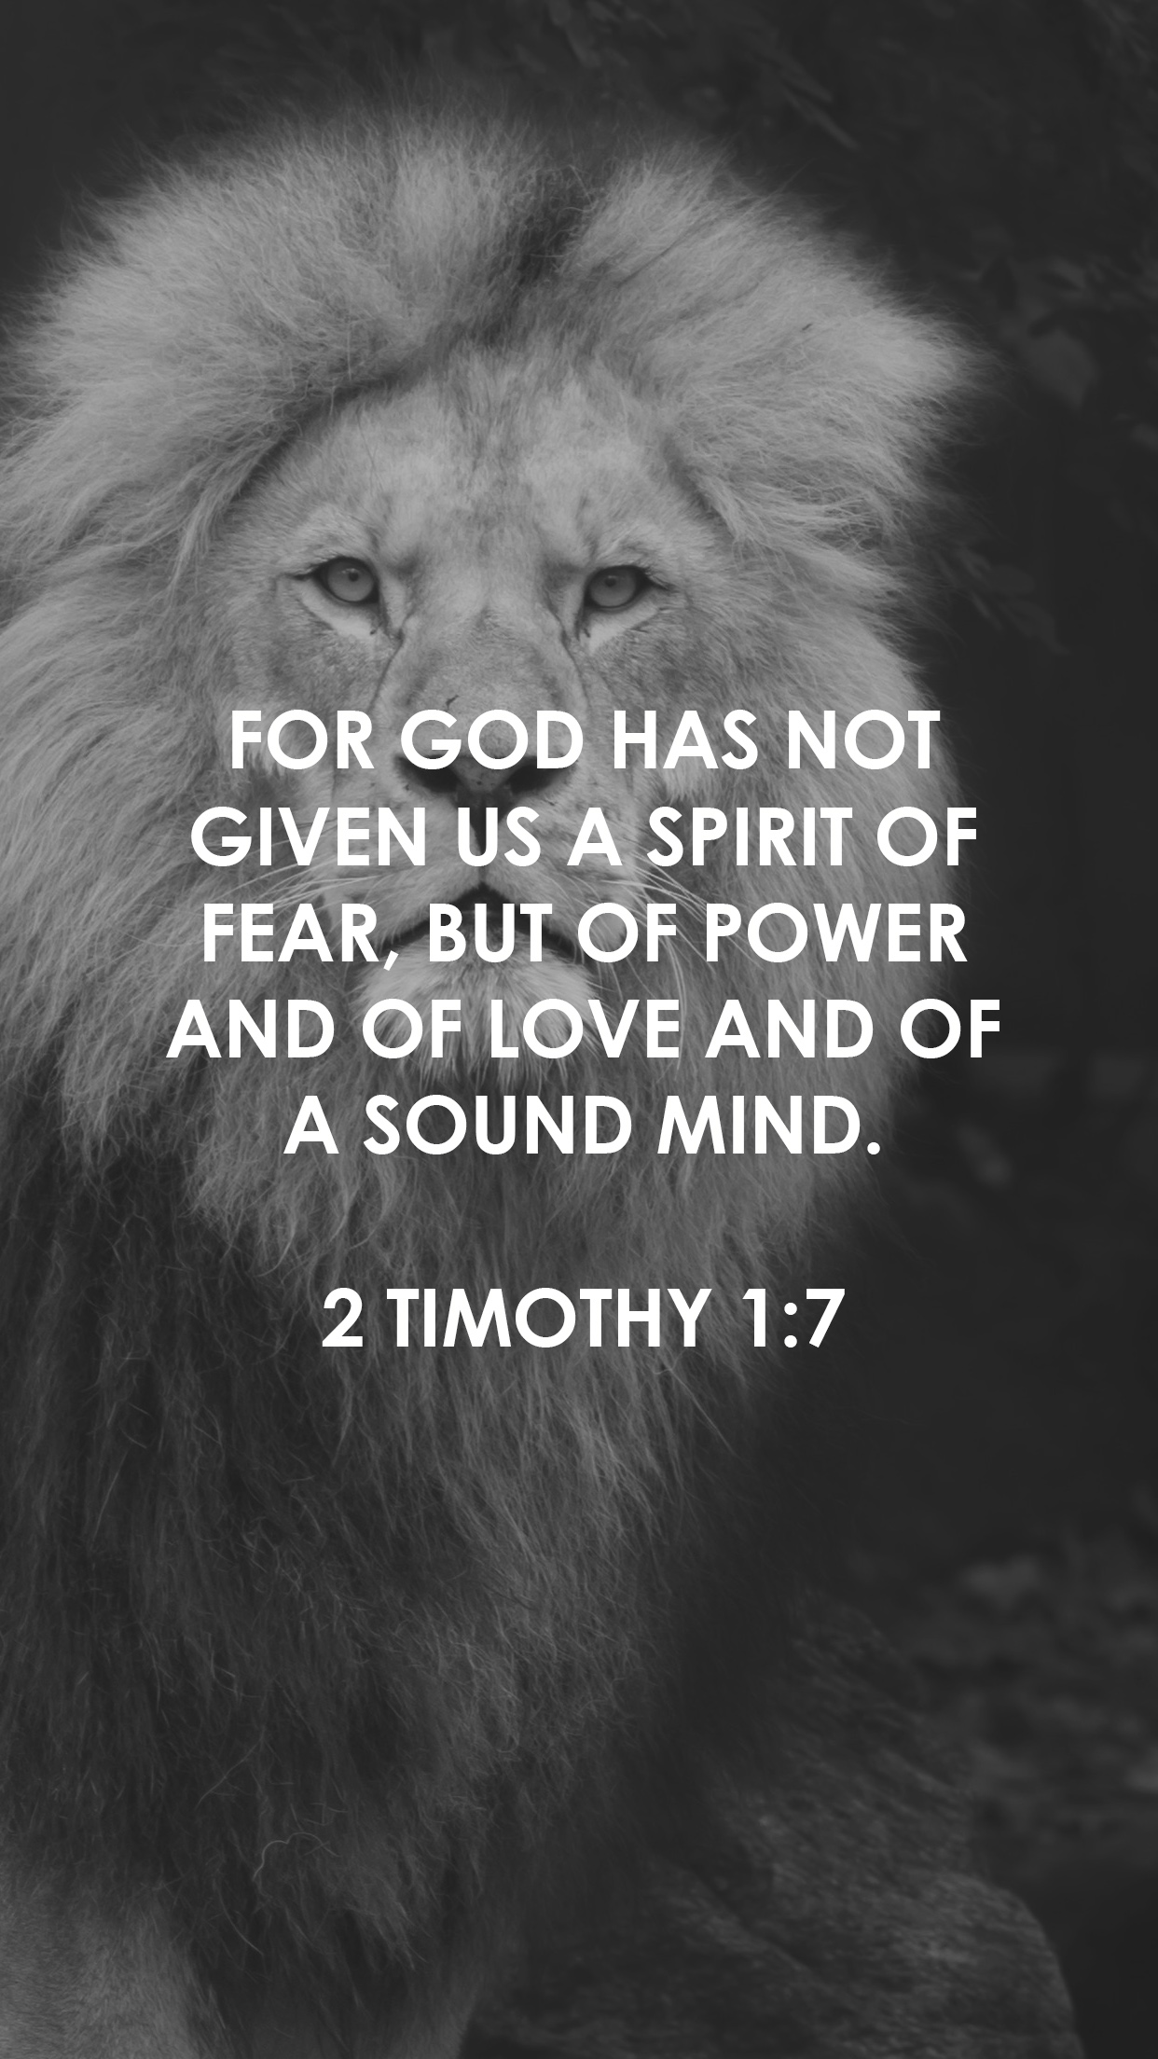
Do not live in
FEAR
But live in
FAITH.

Slide 57
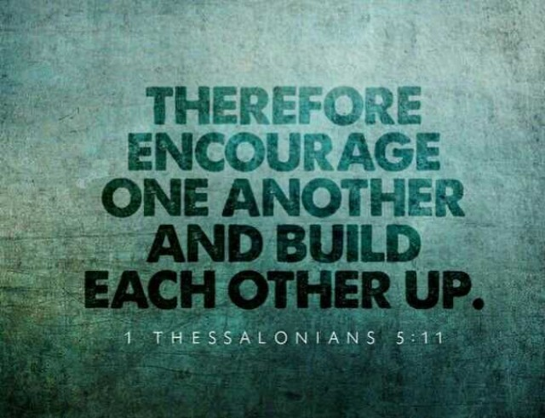
Do not live in
FEAR
But live in
FAITH.

Slide 58
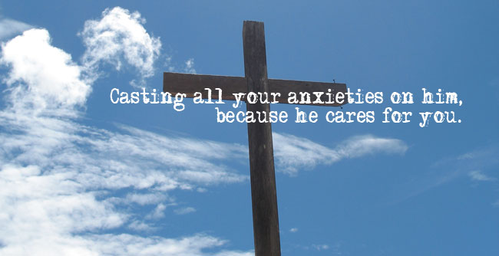
Do not live in
FEAR
But live in
FAITH.

Slide 59
Bible Project
Isaiah part 2:
(~8 minutes)
https://www.youtube.com/watch?v=_TzdEPuqgQg

